Slide 1
NEW 21st CCLC GPRA
Alabama State Department of Education

Slide 2
Objectives
Introduction
What is GPRA
Federal “large P” verses State “small p”
New GPRA changes
Implementation Timeline
Review the New GPRAs
Collecting and Reporting the New GPRA Data

Slide 3
The Nita M. Lowey 21st CCLC program, like most programs funded through Congressional appropriations, is subject to the Government Performance and Results Act (GPRA). This Act dictates that metrics referred to commonly as GPRA measures or “The GPRA” serve as program outcomes to complete the required Annual Performance Report (APR) submitted to Congress. In 2020, The United State Department of Education(USDOE) approved five new GPRA for the 21st CCLC program: Statewide Assessments, Grade Point Average, School Day Attendance, Teacher-Reported Behaviors, and Student Engagement in Learning. Data will be collected during the school year of 2021-2022, which begins this summer. The State is the authoritative source for the State data. The purpose of 21APR is to gather data to Congress and the USDOE.

Slide 4
What is the GPRA?
Government Performance and Results Act (GPRA)
Required outcomes reported each year to Congress
Help us tell our data story
Critical for continued program funding!

Slide 5
Federal “Large P” verses State “small p”

Slide 6
"Large P" verses “small p’s”
Federal-level "Large P" | State-level “small p”
Includes regulations, nonregulatory guidance, reporting requirements, and certain communications from USDOE. | Per the USDOE, States have the discretion to make decisions on “small p” policies.
Per the USDOE, States do not have the discretion to make decisions on "Large P" policies, which are communicated to the States via guidance documents and federal publications. | States must communicate these decisions to the State’s Grantees for the purpose of consistent reporting on APR data.
 | Decisions need to be documented and transparent.

Slide 7
The core “small p” decisions are tied directly to the GPRA measures themselves. But there are “small p” decisions in all the data elements in 21APR. “Small p” decisions for implementation of the New GPRA will be iterative, meaning as database development continues, there may be additional areas of “small p” that emerge. We will continually update you.

Slide 8
“small p” – Policy Decisions about New GPRA *updated*
Federal-level "Large P" | State-level ”small p”
All GPRA are reported on by all States for all participants | In each GPRA, States set ‘small p’ around how improvement is measured or what standards are set (More on this in a moment)
Outcomes are reported for summer and school year
GPRA Measure #3 (School Attendance) is only reported on for school year, not summer. System will not prompt for this outcome when reporting summer
“small p” – Policy Decisions about Terms *updated
Each State must report annual performance in two terms – Summer and School Year | Exact length of school year or summer vary by State and may occur as quarters, inter-sessions, trimesters, or year-round cycles.
 | States determine term start and end dates and/or whether a center’s program is part of school year, summer or both.
 | SEAs will advise programs that have all year programs whether to report separate summer data

Slide 9
“small p” – Policy Decisions about Activities
Federal-level "Large P" | State-level ”small p”
Activities are organized according to federal categories -- based on Section 4205(a) | Chart the alignment of your States’ activities categories to 21APR activities categories, particularly where the categories are not identical in nature.
“small p” – Policy Decisions about Staffing
Federal-level "Large P" | State-level ”small p”
Staffing are organized according to categories put forward by the Department of Education. | Guide Grantees on how to categorize unique staffing structures or arrangements.

Slide 10
The New GPRA
GPRA | Time Period | Grade Levels | Performance Measured/ Data Type
1. Percentage of students in grade 4-8 participating in 21st CCLC programming during the school year and summer who demonstrate growth in reading and language arts on state assessments. Percentage of students in grade 4-8 participating in 21st CCLC programming during the school year and summer who demonstrate growth in mathematics on state assessments. | School Year | 4-8 | Alabama Comprehensive Assessment Program (ACAP)
2. Percentage of students in grades 7-8 and 10-12 attending 21st CCLC programming during the school year and summer with a prior-year unweighted GPA of less than 3.0 who demonstrated an improved GPA. | School Year | 7-8 10-12 | GPA
3. Percentage of students in grades 1-12 participating in 21st CCLC during the school year who had a school day attendance rate at or below 90% in the prior school year and demonstrated an improved attendance rate in the current school year. | School Year | 1-12 | Attendance
4. Percentage of students in grades 1-12 attending 21st CCLC programming during the school year and summer who experienced a decrease in in-school suspensions compared to the previous school year. | School Year | 1-12 | In-school Suspension
5. Percentage of students in grades 1–5 participating in 21st CCLC programming in the school year and summer who demonstrated an improvement in teacher-reported engagement in learning. | School Year | 1-5 | Surveys

Slide 11
New GPRA Changes

Slide 12
APR Data Elements

Slide 13
What’s Staying the Same What is Changing
 | Staying the Same | Changing
Activities | 16 Categories | N/A
Staffing | Nine Categories (paid and volunteer) | N/A
Participation | Total number of participants by grade level Race/Ethnicity Sex Population Specifics | Student Attendance – replacing Days with Hours Entered in hours by grade level
Outcomes |  | New GPRA Outcomes are entered on All Students who participate in 21st CCLC

Slide 14
Participation
Grade Level and Student Attendance
Participation is based on the students enrolled and attended programming at the 21st CCLC center during the summer or school year. Choose the grade the students are currently enrolled in or, if summer, EZ Reports will automatically roll the students up to the next grade level. For example, students that were in the 2nd grade have been rolled up to 3rd grade in the new 2021-2022 school year. Enter the total number of participants who attended based on the number of hours they participated in each session at the center. Enter this separately for each grade level. Enter these totals into 21APR for each grade level. Participation in hours must be reported on all students who participate in 21CCLC.
small “p” Note: Collect the number of hours all students participate in the program.

Slide 15
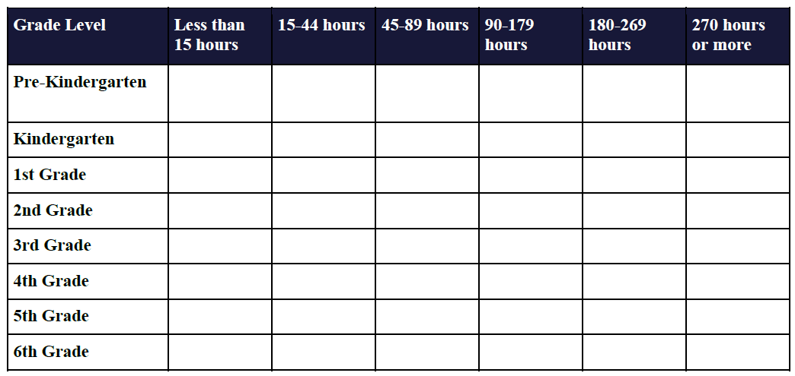
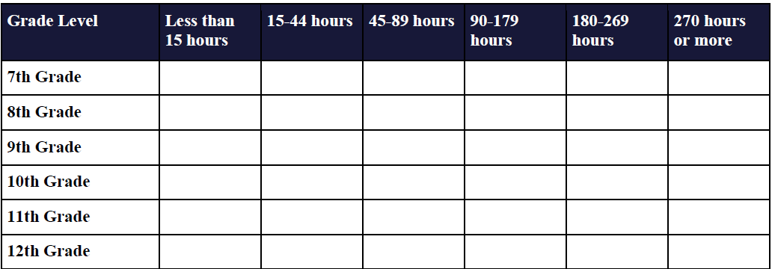

Slide 16
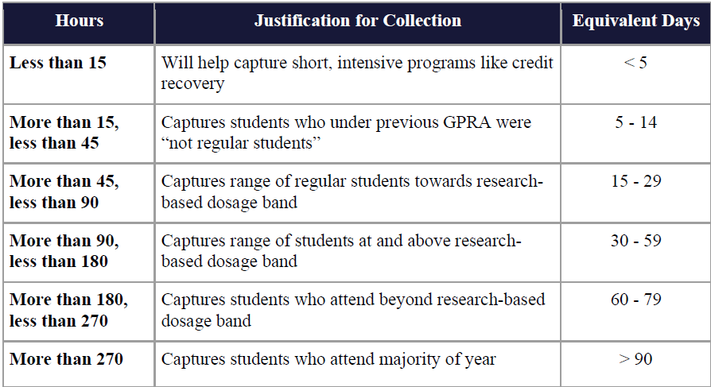
‘Small p ’summary: It is ‘small p ’policy at what number of hours each State starts reporting for those in the less than 15 hours category. Likewise, each State needs to determine how many minutes of attendance counts towards an hour.

Slide 17
Race/Ethnicity, Sex, and Population Specifies
Race/Ethnicity – Aggregate in two groups:
PreK-5th grades and 6th-12th grades into 21APR.
Sex – Aggregate in two groups: PreK-5th grades into 21 APR
Race/Ethnicity | Total PreK-5th | Total 6th-12th
American Indian or Alaska Native
Asian
Black or African American
Hispanic or Latino
Native Hawaiian or Pacific Islander
White
Two or more races
Data not provided
Sex | Total PreK-5th | Total 6th-12th
Male
Female
Data Not Provided

Slide 18
Population Specifics In this section, the number of participants does not have to equal the total participants for the center. Some participants may be reported in more than one category, and some may be registered in none.
 | Total PreK-5th | Total 6th-12th
Students with English Language Proficiency
Students who are eligible for free or reduced-priced lunch
Student with special needs
Family members

Slide 19
Implementation Timeline

Slide 20
Implementation Timeline
Academic Year | Collection | APR Data Entry/ Reporting | Support
2020 - 2021 | Old GPRA | Old GPRA | Prepare to start collecting new GPRA in your State; training and support will be available throughout the year
2021 - 2022 | New GPRA | Old GPRA (from 2020-2021 school year) | Continue attending training and check ins for high quality data validity under new GPRA
2022 - 2023 | New GPRA | New GPRA (from 2021-2022 school year) | Ongoing support and training for data entry and collection of new GPRA

Slide 21
A Closer Look at Implementation for this Year
Time Period | Collection | Data Entry/ Reporting
Summer 2021 | If you have summer programming, collect new GPRA data | Old GPRA (from 2020-2021 school year)
Fall 2021 | New GPRA | Old GPRA (from 2020-2021 school year)
Spring 2022 | New GPRA | When system opens, you will begin reporting your New GPRA data for first time.
In December 2021, you will certify the old GPRA data for the last time!

Slide 22
Review the New GPRAs

Slide 23
NEW GPRA - GPRA 1
Percentage of students in grades 4-8 participating in 21st CCLC programming during the school year and summer who demonstrate growth in reading and language arts on State assessments.
Percentage of students in grades 4-8 participating in 21st CCLC programming during the school year and summer who demonstrate growth in mathematics on State assessments.
“Small p” Note: Collect the number of students in grades 4-8 participating in the program during the school year and summer who demonstrate growth in reading and language arts and mathematics on the state assessment.

Slide 24
NEW GPRA- GPRA 2 Academic Achievement
Percentage of students in grades 7-8 and 10-12 attending 21st CCLC programming during the school year and summer with a prior-year unweighted GPA of less than 3.0 who demonstrated an improved GPA.
“Small p”: Collect the number of students in grades 7-8 and 10-12 participating in the program during the school year and summer with a prior year unweighted GPA of less than 3.0 who demonstrated an improved GPA.

Slide 25
The State may provide more than one crosswalk/conversion or a crosswalk/conversion with several equivalents provided e.g., numerical grades, letter grades, proficiencies etc. For example:

Slide 26
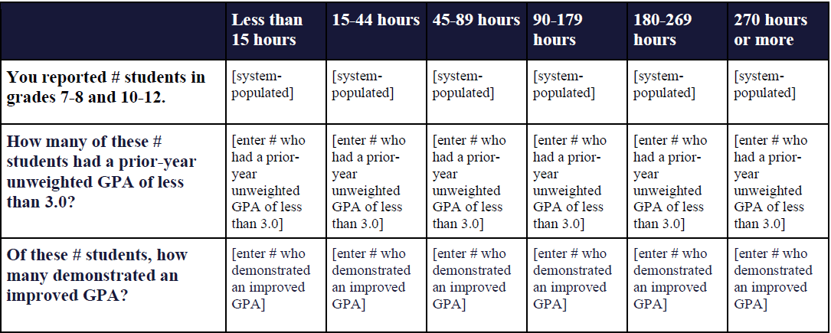
The State might use a large-scale reform for grades.
For example:

Slide 27
NEW GPRA- GPRA 3
Percentage of students in grades 1-12 participating in
21st CCLC during the school year who had a school day attendance rate at or below 90% in the prior school year and demonstrated an improved attendance rate in the current school year.
‘Small p ’summary: This GPRA is only reported in the school year, not in the summer. Collect the number of students in grades 1-12 during the school year who had a school day attendance rate at or below 90% in the prior school year and demonstrated an improved attendance rate in the current year.

Slide 28
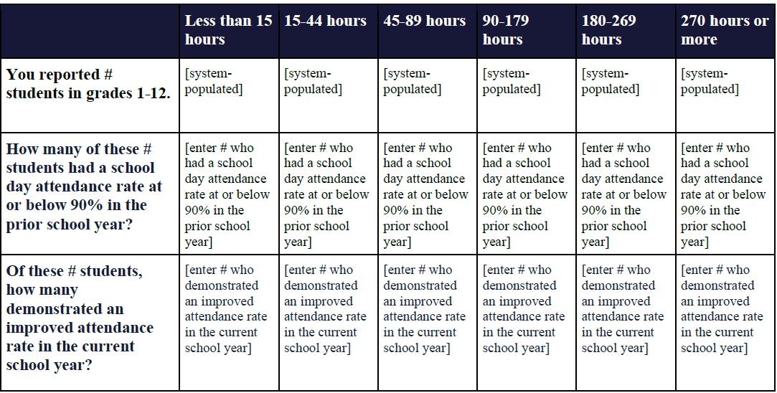
‘Small p ’summary: This GPRA is only reported in the school year, not in the summer. The State will define what improved attendance rate means e.g., how much of an improvement needs to be shown in order for it to be counted.

Slide 29
NEW GPRA- GPRA 4
Percentage of students in grades 1-12 attending 21st CCLC programming during the school year and summer who experienced a decrease in in-school suspensions compared to the previous school year.
This will be entered once for the summer and once for the school year. You may have duplicative data, and that is okay.
Note: Collect the number of students in grades 1-12 attending the program during the school year and summer who experienced a decrease in in school suspensions compared to the previous school year.

Slide 30
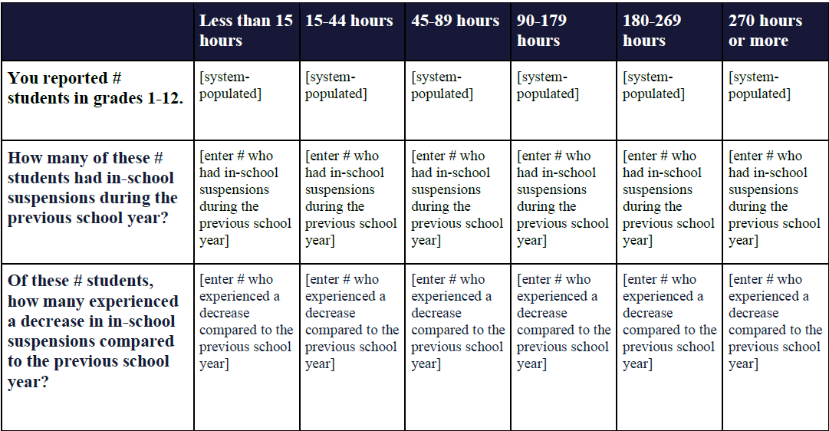

Slide 31
NEW GPRA- GPRA 5
Percentage of students in grades 1-5 participating in 21st CCLC programming in the school year and summer who demonstrated an improvement in teacher reported engagement in learning.
Note: Collect the number of students in grades 1–5 participating in the program during the school year and summer who demonstrate an improvement in teacher-reported engagement in learning (Collected through Teacher Survey for Reading or Math).

Slide 32
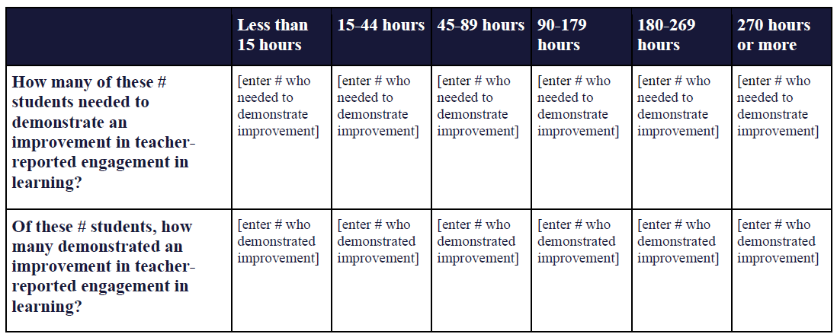
‘Small p ’summary: for this GPRA metric, the state will collect teacher survey data

Slide 33
NEW GPRA: What Do You Need to Collect and Report?

Slide 34
New GPRA Measurement Chart
Outcome #1 | Outcome #2 | Outcome #3 | Outcome #4 | Outcome #5 | Participation
Academic Achievement Collect the number of students in grades 4-8 participating in the program during the school year and summer who demonstrate growth in reading and language arts and mathematics on the state assessment. | Academic Achievement Collect the number of students in grades 7-8 and 10-12 participating in the program during the school year and summer with a prior year unweighted GPA of less than 3.0 who demonstrated an improved GPA. | School Day Attendance Collect the number of students in grades 1-12 during the school year who had a school day attendance rate at or below 90% in the prior school year and demonstrated an improved attendance rate in the current year. | Behavior Collect the number of students in grades 1-12 attending the program during the school year and summer who experienced a decrease in in school suspensions compared to the previous school year. | Student Engagement in Learning Collect the number of students in grades 1–5 participating in the program during the school year and summer who demonstrate an improvement in teacher-reported engagement in learning (Collected through Teacher Survey for Reading or Math). | Hours Collect the number of hours all students participate in the program.

Slide 35
Performance Measured & Data Type
GPRA |  | Grade | Report
GPRA 1 | Academic Achievement | 4-8 | State Assessment – reading and math
GPRA 2 | Academic Achievement | 7-8 10-12 | Grade Point Average (GPA)
GPRA 3 | School Day Attendance | 1-12 | Attendance
GPRA 4 | Behavior | 1-12 | In-school suspension
GPRA 5 | Engagement in Learning | 1-5 | Engagement in Learning - Surveys

Slide 36
New GPRA and EZReports
EZ Report has some helpful videos on the Live Attendance options. Click the Help and Support button – User Guide – then search for “In/Out (Sign-in Sheets),” Live Attendance, Parent PIN”, and/or “ID Scan.”

Slide 37
New GPRA and EZReports
To reflect the student attendance time more accurately, you can request “Live Attendance,” “Parent PIN Sign In/Out,” or “ID-Scan” by creating a support ticket and making the request. These options will time stamp the attendance of each child. All sites will be switched to Live Attendance for the Fall.

Slide 38
New GPRA and EZReports
If your site was previously doing weekly attendance through EZ Report, you have now been switched to “In/Out (Sign-in Sheets). This change will help with the new GPRA Measure to calculate student hours instead of days. Please make sure to change the times for students that come or leave early. All students check in and check out times must be their actual time, not just the center's open and close time.

Slide 39
Recap-How does this affect me?
Biggest change:
Recording hours instead of days
Requiring more detail and accuracy when reporting student attendance in EZReports
Reporting outcomes for all students, not just regular attendees
Starting with students who participate in summer of 2021

Slide 40
What if I already enter my student attendance with accurate hours?
Please keep doing so!
Here’s why:
We will look at what you’re submitting and use your data to build your APR reports for next year

Slide 41
I have questions…

Slide 42
Erika E. Rucker eatmoef@auburn.edu Linda Dean lhd0001@auburn.edu Linda Williams lmw0085@auburn.edu Chris Groccia chrisgroccia@Hotmail.com

